Slide 1
Thermal Testing
Building Regulations
U Values
Life Cycle Assessment

Slide 2
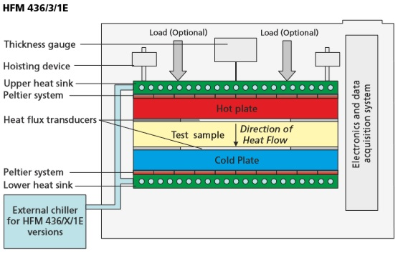
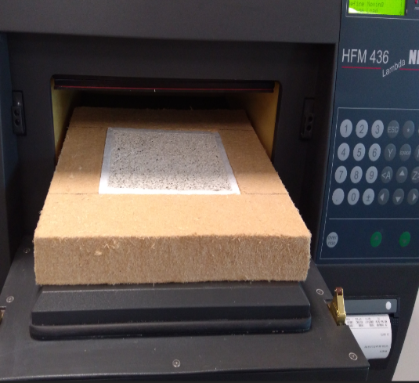
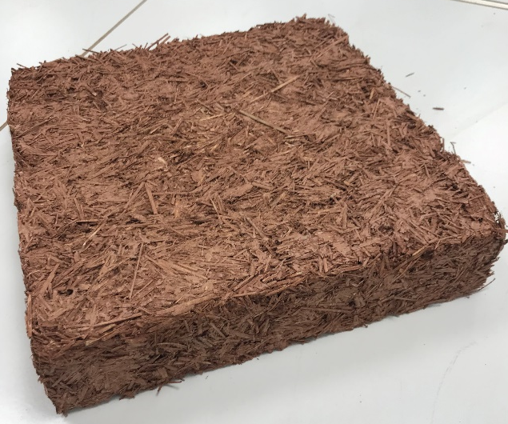
Thermal Testing: In laboratory
Heat Flow Meter

Slide 3
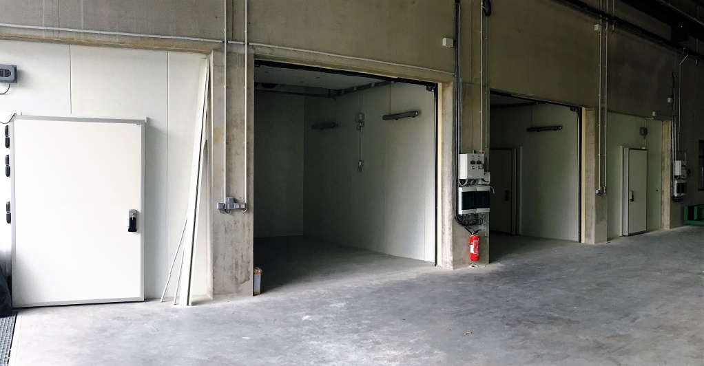
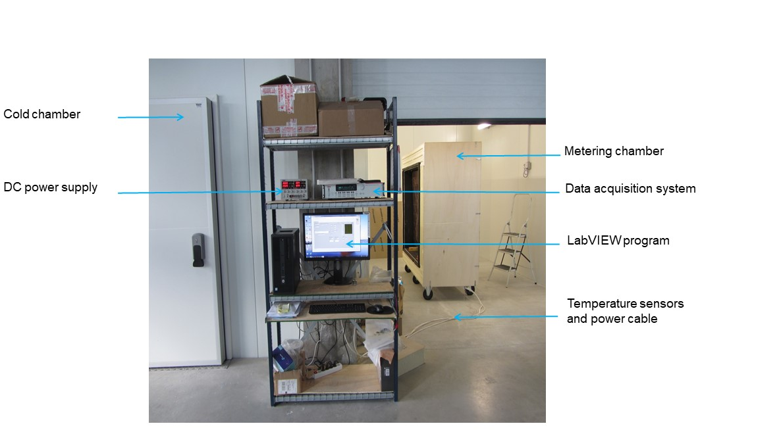

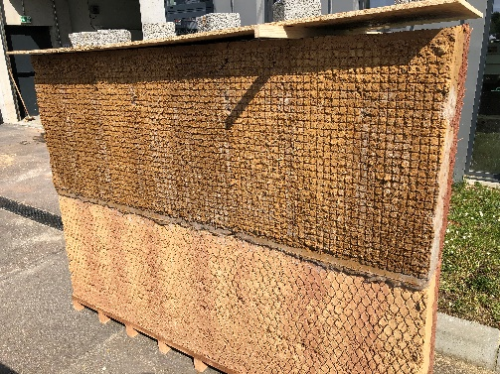
Thermal Testing: In laboratory at real scale
Typical Hot Box apparatus schematic [ASTM C1363]
Overview of the experimental device used for thermal characterization of cob wall

Slide 4
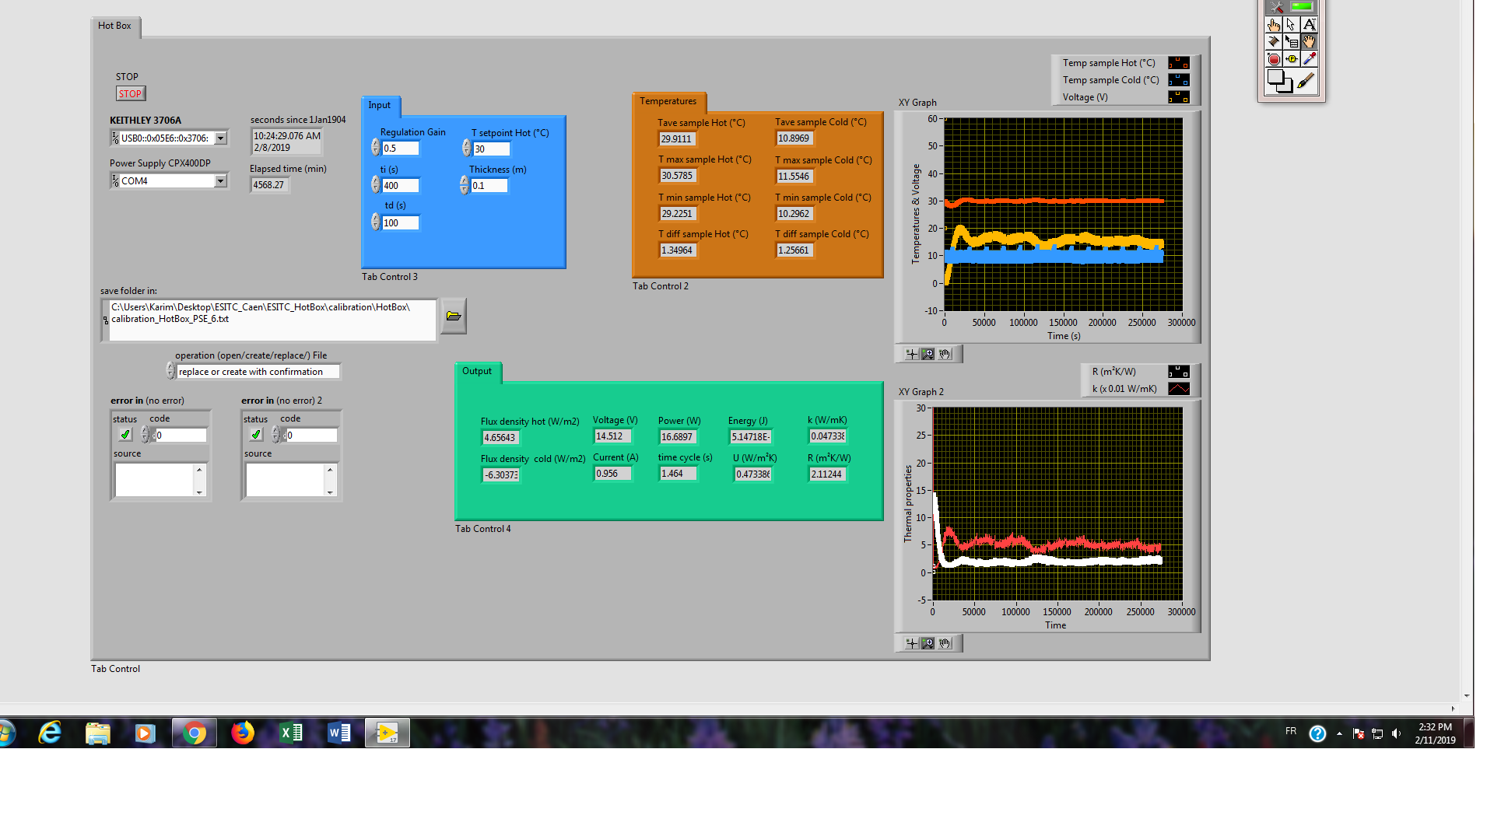
Thermal Testing: In laboratory at real scale

Slide 5
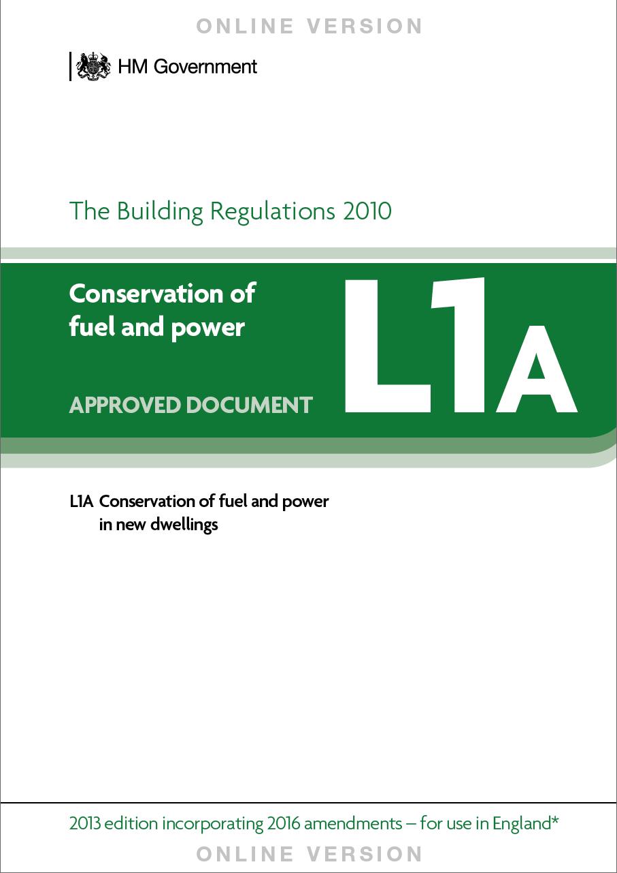
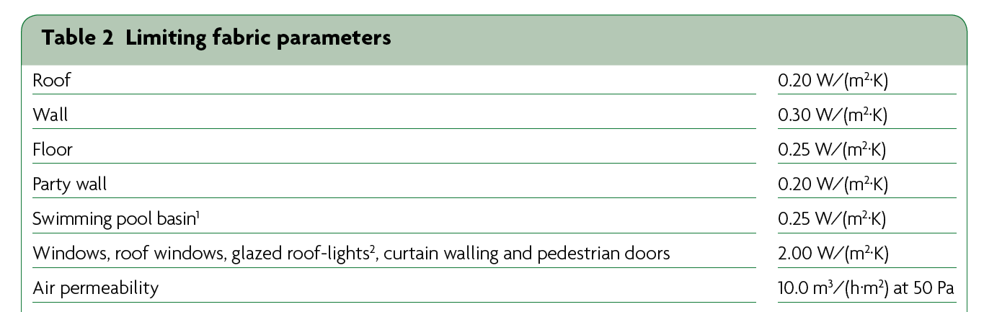
UK Building regulations: Part L1 A

Slide 6
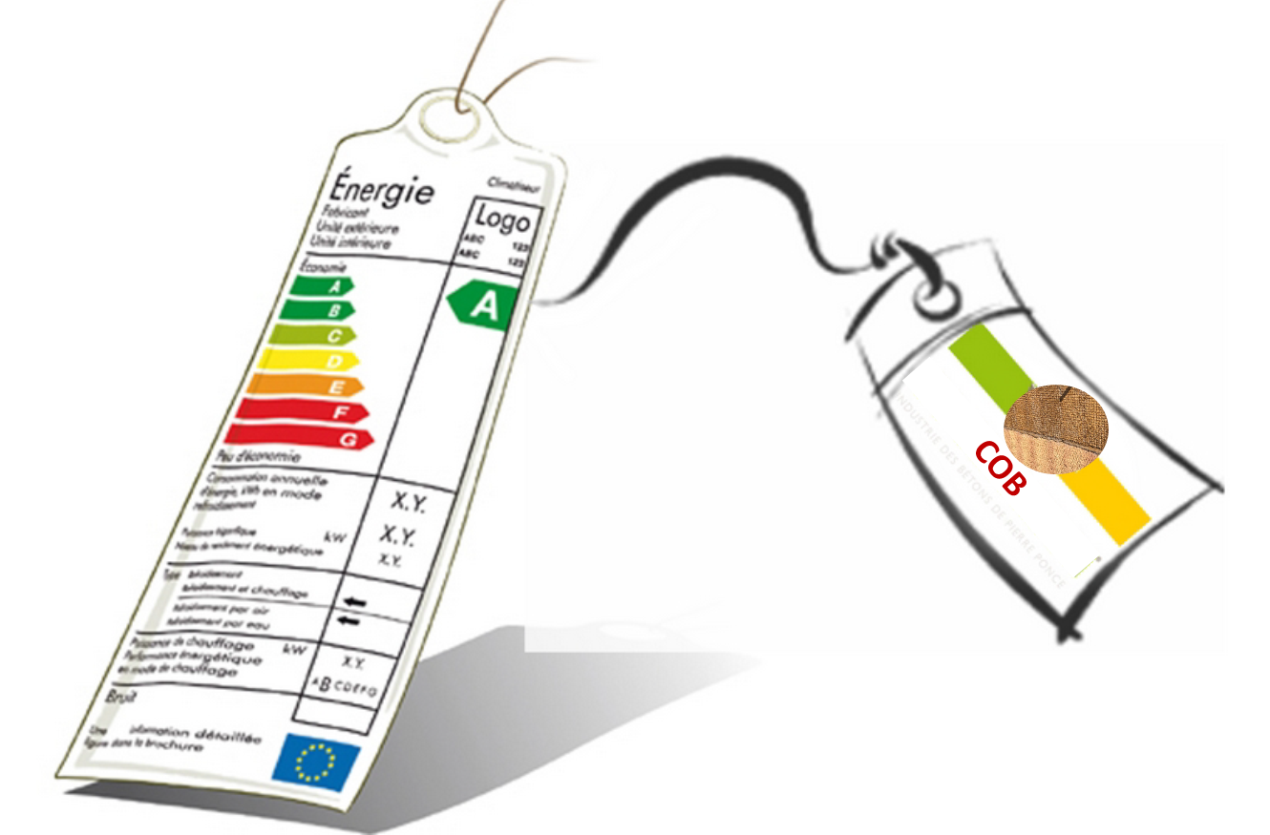

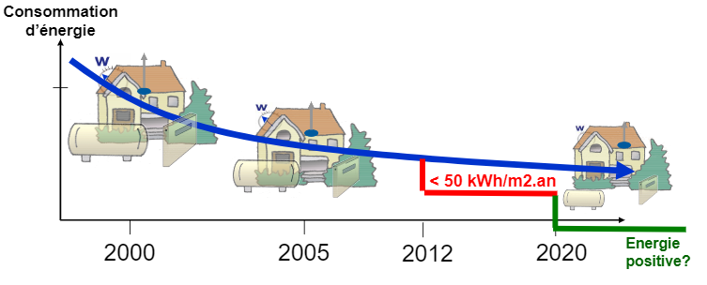
FR Building regulations: RT2012
Thermal regulation 2012 “RT 2012”: These are three performance requirements:
The maximum energy efficiency of the building
A maximum consumption primary energy of 50 kWh/m²/year
Summer thermal comfort on conventional indoor temperature
The expected “U” for the walls :
U ≤ 0,36 W/m².K → R ≥ 2,77 m².K/w

Slide 7
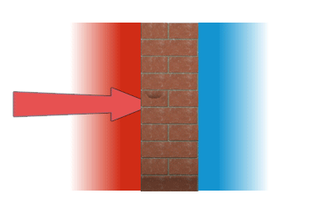
Cob and U Values
The U-value of an insulating layer depends on the thermal conductivity (λ) of the material and its thickness (e):
U = λ/e .
FR SOIL | Thermal Conductivity W/(m∙K) | U Value (m²∙K)/W
1 | 0,168104 | 1,800
2 | 0,175374 | 1,710
3 | 0,180617 | 1,666
UK SOIL | Thermal Conductivity W/(m∙K) | U Value (m²∙K)/W
1 | 0,196145 | 1,530
2 | 0,18902 | 1,600
3 | 0,196319 | 1,530
[Source: Weber]

Slide 8
Cob and U Values
Traditional Cob | Density | Thickness m | Cond. W/m K | Resistance m2 K/W
Internal surface |  | n/a | n/a | 0.12
Cob | 1600 | 0.700 | 0.64 | 1.09
External Surface |  | n/a | n/a | 0.06
Total Resistance |  |  |  | 1.27
U-Value |  |  |  | 0.79
How thick would a traditional cob wall have to be to pass regulations?
Traditional Cob | Density | Thickness m | Cond. W/m K | Resistance m2 K/W
Internal surface |  | n/a | n/a | 0.12
Cob | 1600 | 2.00 | 0.64 | 3.13
External Surface |  | n/a | n/a | 0.06
Total Resistance |  |  |  | 3.30
U-Value |  |  |  | 0.30
Two metres!

Slide 9
Cob and U Values
How light would a cob wall have to be to pass regulations?
Light Cob | Density kg/m3 | Thickness m | Cond. W/m K | Resistance m2 K/W
Internal surface |  | n/a | n/a | 0.12
Cob 25% fibre | 673 | 0.600 | 0.183 | 3.28
External Surface |  | n/a | n/a | 0.06
Total Resistance |  |  |  | 3.46
U-Value |  |  |  | 0.29
Less than half the density
Unfortunately, this lightweight cob wall could not support a second floor or a roof

Slide 10
Cob and U Values
The solution – A composite cob wall
Composit Cob | Density kg/m3 | Thickness m | Cond. W/m.K | Resistance m2 K/W
Internal surface |  | n/a | n/a | 0.12
Dense Cob UK6 5% Hemp straw | 1600 | 0.300 | 0.45 | 0.67
Lightweight Cob UK3 50% Hemp shiv | 340 | 0.300 | 0.11 | 2.73
External Surface |  | n/a | n/a | 0.06
Total Resistance |  |  |  | 3.57
U-Value W/m2K |  |  |  | 0.28
This wall achieves the right U value for Building Regulations

Slide 11
Cob and U Values
The CobBauge wall with finishes
Composite Cob + finishes | Density kg/m3 | Thickness m | Cond. W/m.K | Resistance m2 K/W
Internal surface |  | n/a | n/a | 0.12
Internal earthen plaster |  | 0.03 | 0.44 | 0.07
Dense Cob UK6 2.5% Hemp straw | 1423 | 0.250 | 0.44 | 0.57
Lightweight Cob UK3 50% Hemp shiv | 340 | 0.300 | 0.11 | 2.73
Lime render |  | 0.03 | 0.60 | 0.05
External Surface |  | n/a | n/a | 0.06
Total Resistance |  |  |  | 3.59
U-Value W/m2K |  |  |  | 0.28
The same U value, standard finishes, and is now 556mm thick

Slide 12
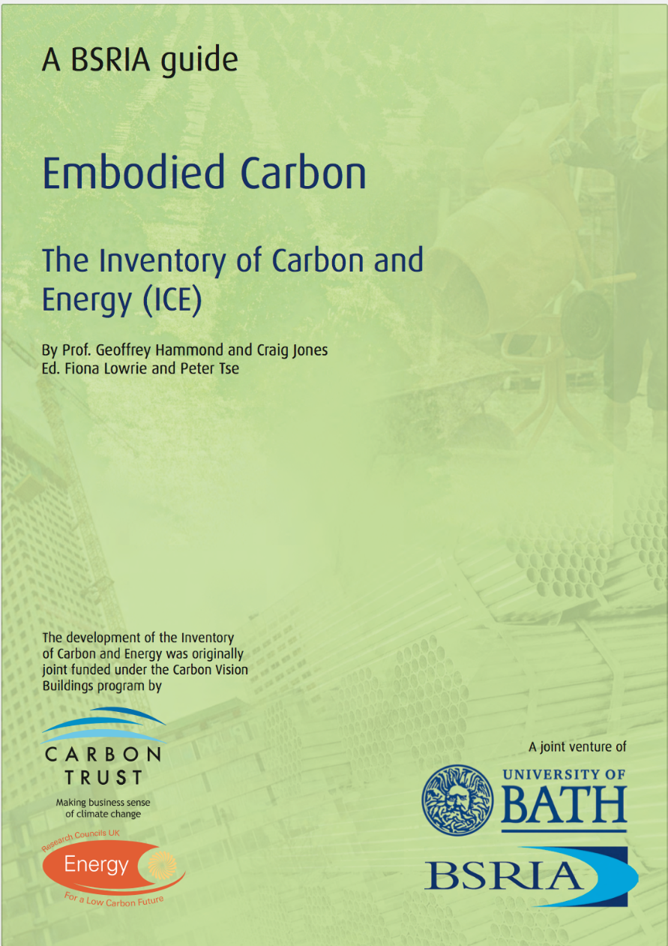
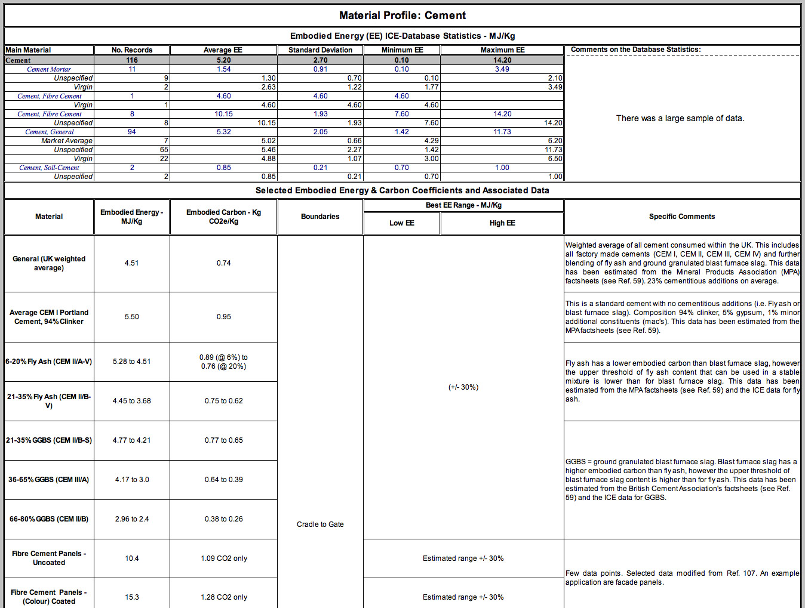
Life Cycle Assessment – Embodied Energy

Slide 13

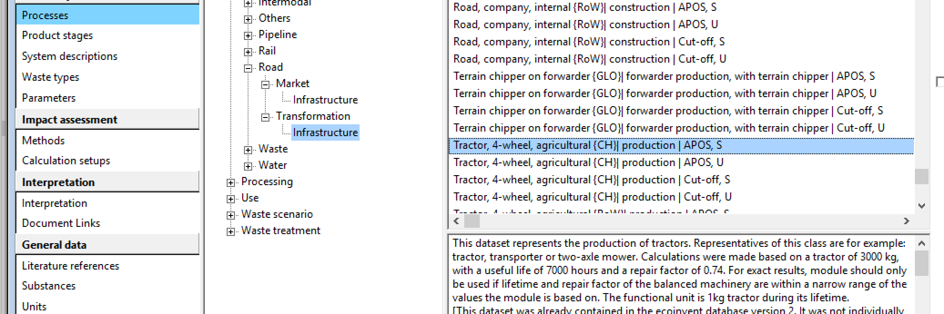
Life Cycle Assessment – Embodied Energy
Calculating LCA - SimaPro

Slide 14
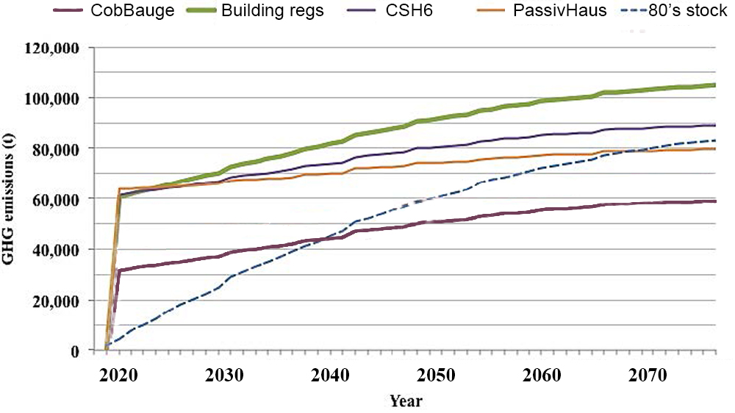
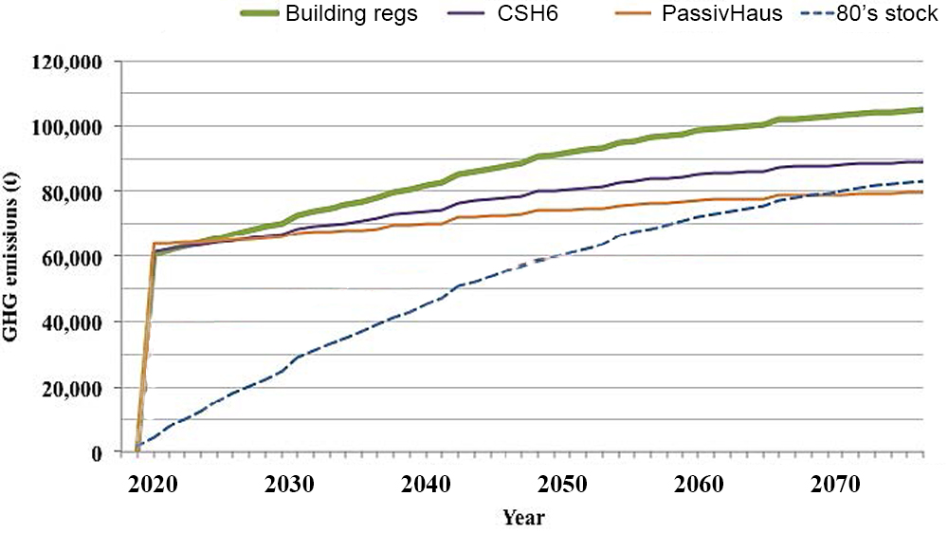
Life Cycle Assessment – Why is this important?
Adapted from Jukka Heinonen
This is happening now!

Slide 15
Thank you

